Slide 1

Department of Information and Communication Technology Course Title : Project-I Course Code : ICT-1200 Presentation Topic: Cricket Game Simulator Subtitle: "ICT Premier League 2024"
Presented By:
Kuldip saha mugdha (IT-22018)
Project Supervisor:
Dr. Monir Morshed sir
Professor , Dept. of ICT
Mawlana Bhashani Science and Technology University , Tangail

Slide 2
Context
Welcome to the presentation
Objective
Programming language
Introduction
Purpose of the project
Project scope
Design and user interaction
Limitation
Conclusion
Q&A.

Slide 3
Objective:
The objective of the code is to simulate a cricket game, specifically the ICT Premier League 2024. The code allows users to:
Select two teams from a list of options.
Simulate a toss to determine which team bats first or fields first.
Play through the innings of each team, recording runs scored and wickets taken.
Determine the winner based on the runs scored by each team.
Overall, the code aims to provide an interactive and realistic simulation of a cricket match, allowing users to experience the excitement of the sport within the context of the ICT Premier League 2024.

Slide 4
Programming Language
C++ is a widely used programming language known for its efficiency, performance, and flexibility. It supports both procedural and object-oriented programming paradigms, making it suitable for a wide range of applications, from system programming to software development.
Features of C++
object oriented programming(OOP) language.
File Handling
Exception Handling
Multithreading

Slide 5
Introduction:
Briefly introduce the project and its purpose.
Mention that it's a cricket game simulator for the ICT Premier League 2024.

Slide 6
Purpose of the Project
The purpose of the Cricket Game Simulation Project is to provide users with an entertaining and educational experience of playing cricket in a simulated environment. Through interactive gameplay, the project aims to familiarize users with the rules and dynamics of cricket, while also promoting skill development, community engagement, and creativity. By combining entertainment with learning opportunities, the project seeks to engage users of all ages in the exciting world of cricket, fostering a love for the sport and promoting programming skills in the process.

Slide 7
Project Scope
Development of a command-line-based cricket game simulation program.
Providing users with an interactive experience of simulating cricket matches.
Creating a realistic representation of cricket gameplay within the constraints of a command-line interface.
Offering users the ability to choose teams, simulate matches, and determine match outcomes.
Implementing basic game rules, including scoring, wicket-taking, and over limitations.

Slide 8
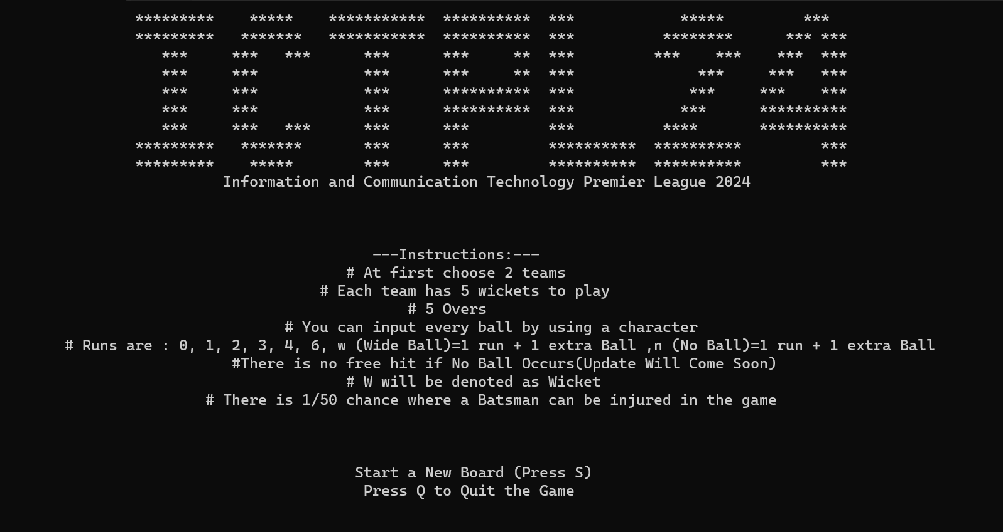
Design and User Interaction(Cont..)
Press S to start the Board

Slide 9
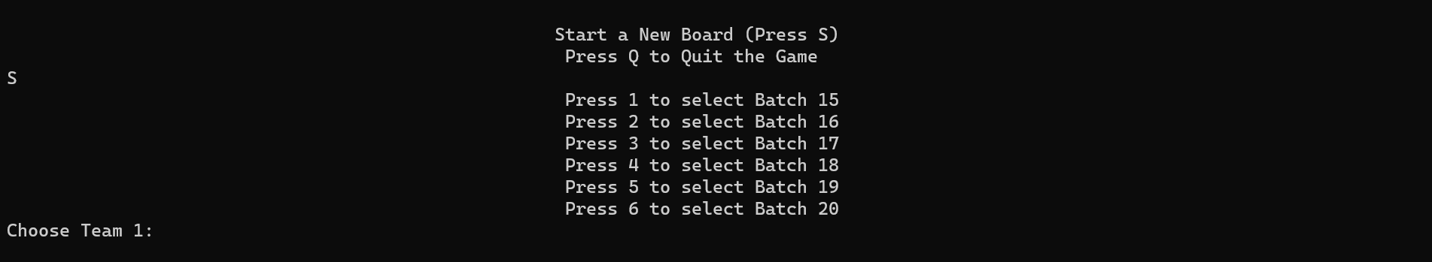
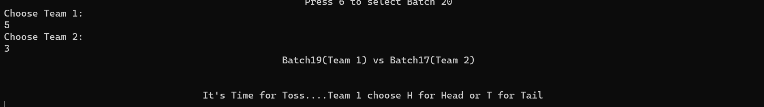
Then choose the teams.
Prepare for the toss.

Slide 10
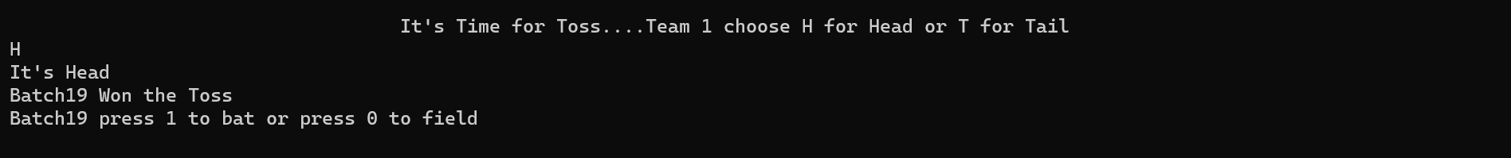
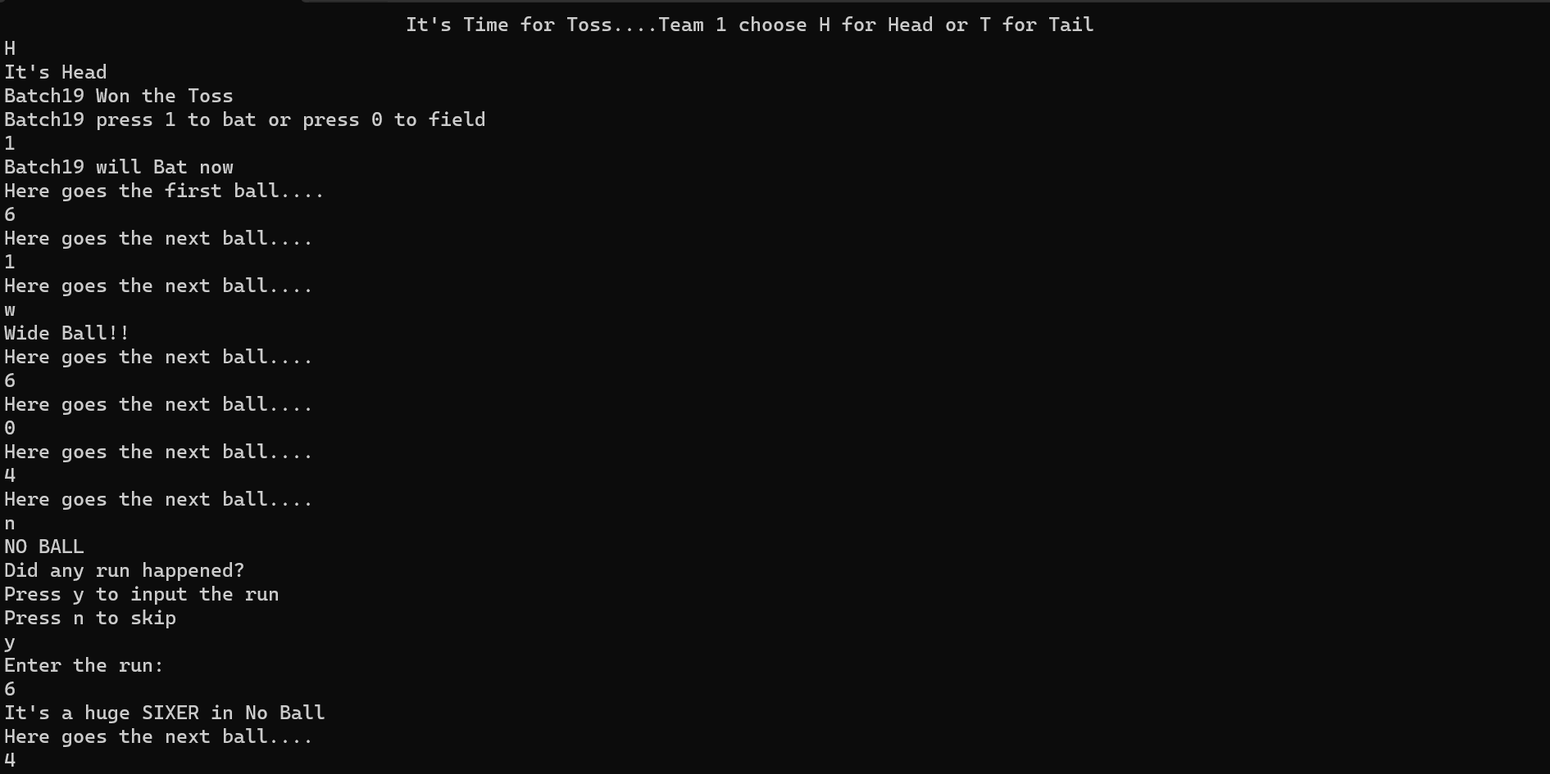
Make toss.
Prepare for 1st innings.

Slide 11
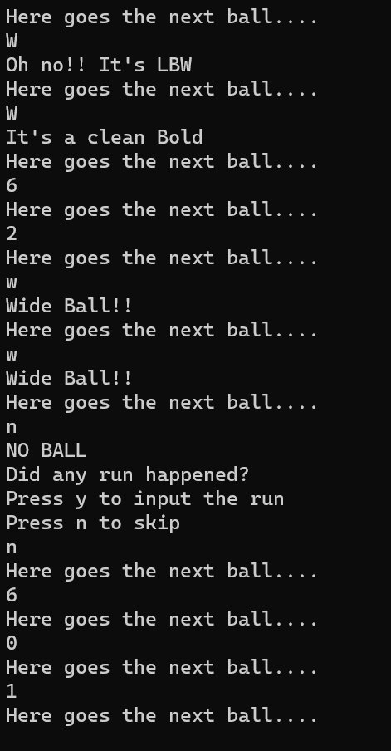
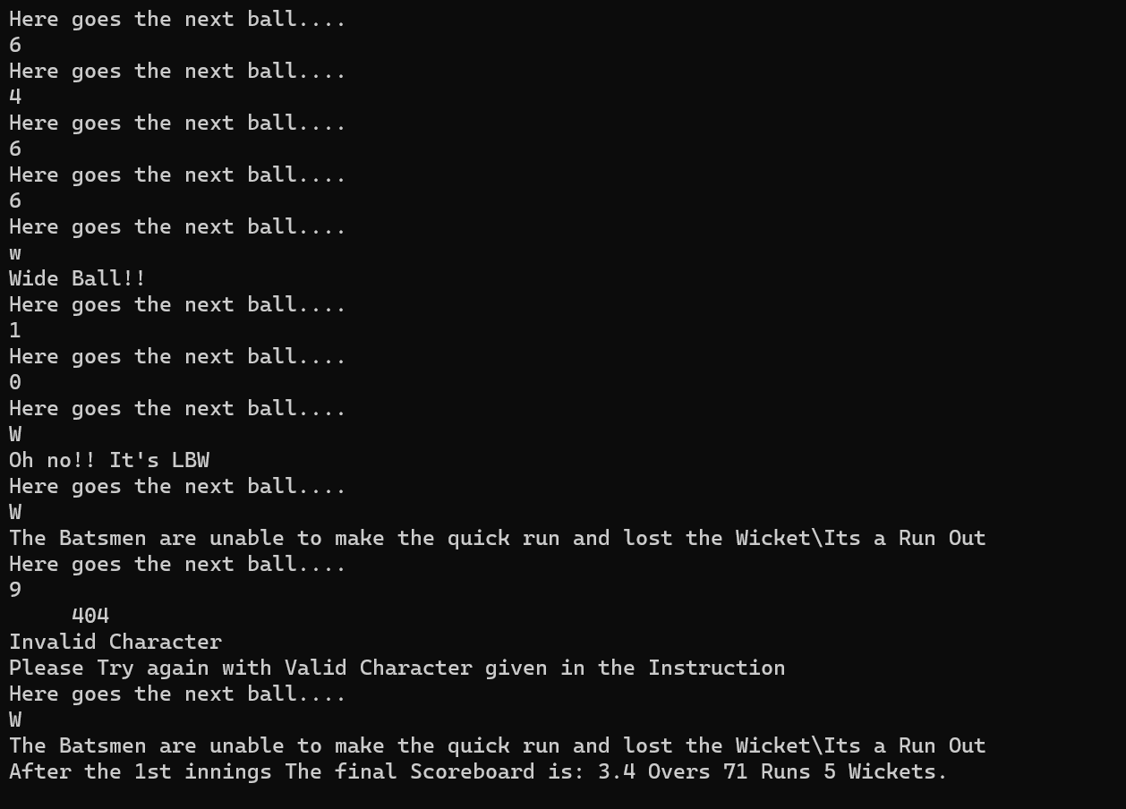
End of the 1st innings and prepare for 2nd innings.

Slide 12
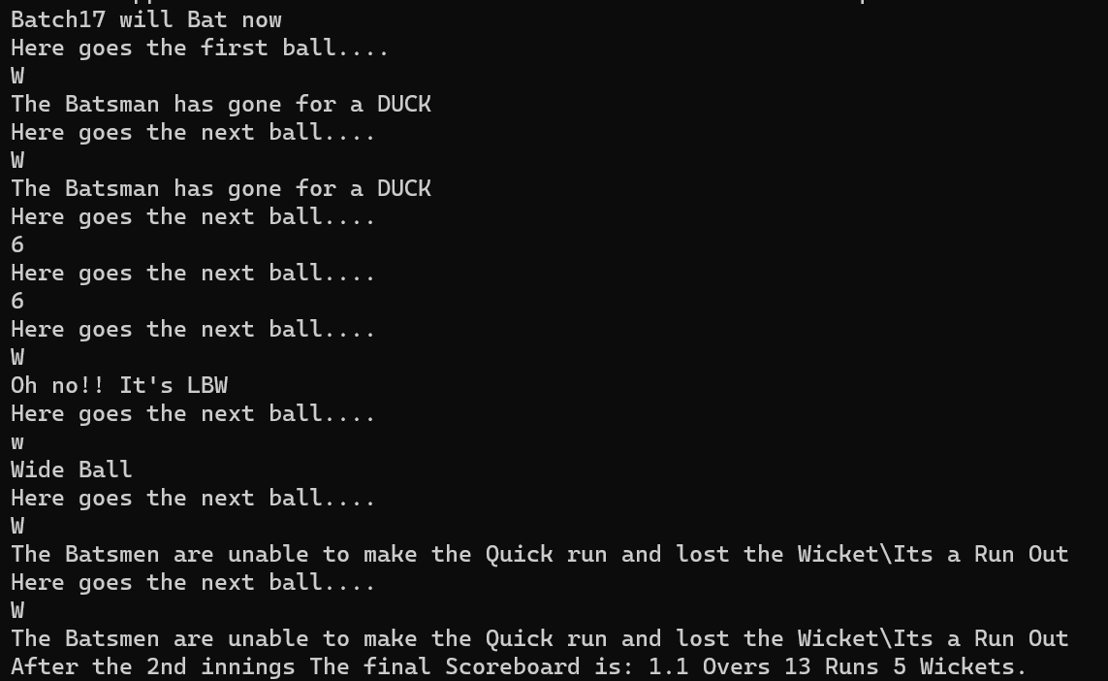
Play 2nd innings.

Slide 13

Show the Final result.
Start a new board or Quit the Console.

Slide 14
Limitations
Command-Line Interface (CLI): The project is limited to a command-line interface, which may not provide the most user-friendly or visually appealing experience compared to graphical user interfaces (GUIs).
Simplistic Gameplay: The gameplay mechanics are relatively simplistic and may not fully capture the complexity and nuances of real cricket matches.
Limited Features: The project lacks advanced features commonly found in commercial cricket simulation games, such as player customization, team management, career modes, and multiplayer functionality.
Input Limitations: User input for simulating ball outcomes is restricted to specific characters, limiting the flexibility and realism of gameplay.
Randomness and Predictability: The project's random number generation for simulating ball outcomes may lead to unpredictable or unrealistic gameplay scenarios.
Scalability and Extensibility: The project may face challenges in scaling up or accommodating additional features, teams, or game modes without significant modifications to the codebase.
Platform Dependency: The project's reliance on specific compilers, libraries, or system configurations may introduce platform dependencies and compatibility issues across different operating systems or development environments.

Slide 15
Conclusion
In conclusion, the Cricket Game Simulation project provides a foundation for a command-line-based cricket game, offering users an interactive and entertaining experience within a simulated cricket match. While the current implementation has its limitations, including a simplistic gameplay model and a command-line interface, it serves as a valuable learning opportunity for programming enthusiasts interested in game development, algorithm design, and user interface design.
Despite its limitations, the project demonstrates key concepts in software development, including input/output handling, conditional logic, function implementation, and random number generation. It also introduces users to the rules and dynamics of cricket, fostering a deeper understanding and appreciation for the sport.

Slide 16
Any Queries? THANK YOU..

